Slide 1
Android Development
Android Studio, Activities & Fragments

Slide 2
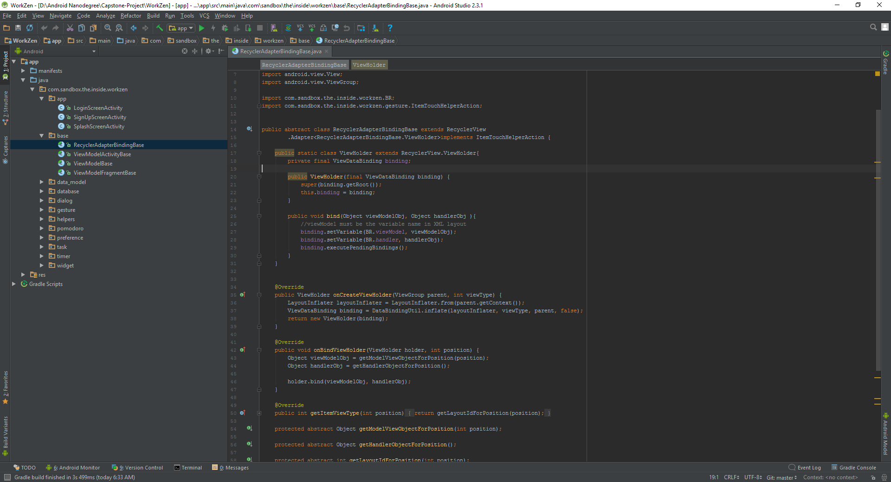
Android Studio
De facto standard for Android development
Some features
Built on the Intelli
Instant Run (Hot swap)
Layout Editor
Built in emulator
Gradle integration
https://developer.android.com/studio/index.html

Slide 3
Activity

